Slide 1
Python Dictionary

Slide 2
# A dictionary is a collection of key:value pairs
# Keys are immutable objects like string, tuple and frozenset.
# Dictionary is ordered - i.e items of a dictinary always print in same order
# Dictionary is changeable - i.e we can add, remove and change items after its creation
# No duplicate key allowed.
# Dictinary item values can be of any type - i.e they support mixed data type

Slide 3
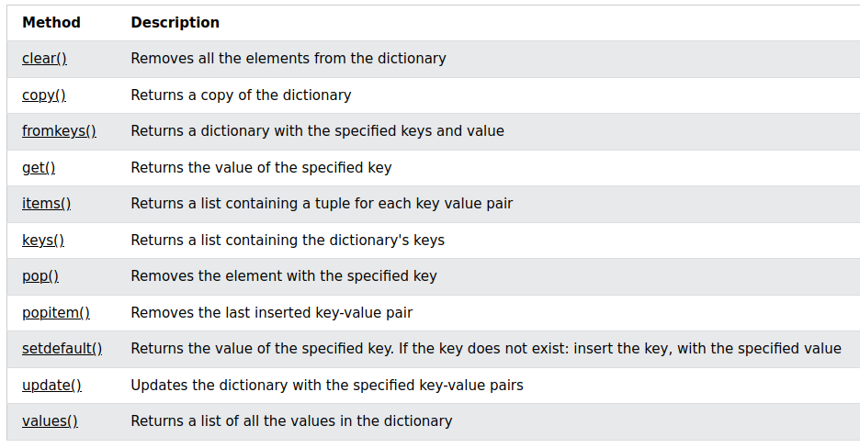
Python Dictionary Methods

Slide 4
Problem 1
How would you add a new key to this dict?
d = {
"name": "Johanth",
"language": "Python",
"state": "Telangana",
}
Key name is: age

Slide 5
Solution 1
1) Using assignment operator
2) Using update() method

Slide 6
Problem
You find this line of code in a .py file:
l[5] = 'Bala'
What can you say about l?
a) It is a dictionary
b) It is a list
c) It could be both
d) Cannot say either with surety

Slide 7
Solution
l = ['alpha', 'beta', 'gamma']
l[0] = "Bala"
l[1] = "Lijiya"
l[2] = "Ashish"
d = {}
d[0] = "Bala"
d[1] = "Lijiya"
d[2] = "Ashish"
print(l)
print(type(l))
print(d)
print(type(d))
['Bala', 'Lijiya', 'Ashish']
<class 'list'>
{0: 'Bala', 1: 'Lijiya', 2: 'Ashish'}
<class 'dict'>

